Slide 1

facinghistory.org

Slide 2
Getting Started: Notes to Teachers
This PowerPoint presentation accompanies Lesson 1: Understanding Identity from the Standing Up for Democracy scheme of work. It is important to read the lesson plan in order to understand its rationale and procedure, and to learn more about specific activities and teaching strategies in the Notes to Teachers section.
This presentation includes verbal instructions for the activities in the Notes beneath each slide. Accessing hyperlinks in PowerPoint involves extra steps: select View - Notes Page - right click on the hyperlink - and select Open Hyperlink. Alternatively, you can access the hyperlinks from Lesson 1: Understanding Identity or by viewing the presentation in Google Slides.
While you may need to modify this presentation to meet the needs of your students, please note that Facing History and Ourselves is not accountable for any changes that alter the presentation's content or original layout.
Notes:
Information about Standing Up for Democracy PowerPoint Slides
Each PowerPoint accompanies a corresponding lesson plan that includes more detailed instructions about the activities and should be read in advance of teaching the lesson.
Wherever possible, we have used images in lieu of writing to encourage the verbal delivery of instructions as a means of boosting focus and to promote active listening skills.
The same image is used for each recurring teaching strategy throughout the scheme of work to facilitate recall and promote student independence.

Slide 3
Understanding Identity

Slide 4
Guiding Questions
What factors shape your identity?
What parts of your identity do you choose for yourself?
What parts of your identity are determined for you by other people or by society?
Notes:
Understanding Identity: Learning Objective
To identify social and cultural factors that help shape our identities by reading and analysing a short story and then creating our own personal identity charts.

Slide 5

Let’s start by thinking about identity . . .
Who am I?
What words or labels would you use to describe yourself?
Notes:
Explain to students that today they will be thinking about what factors make up their identities. Then they will read a story in which the main character deals with the different ways he defines himself and is defined by others.
Next ask students to respond to the two questions in their journals. Explain that they might answer in list form or in complete sentences. Let them know that while they will be sharing their ideas with a partner, they will have a choice about what they share and what they want to keep private.

Slide 6

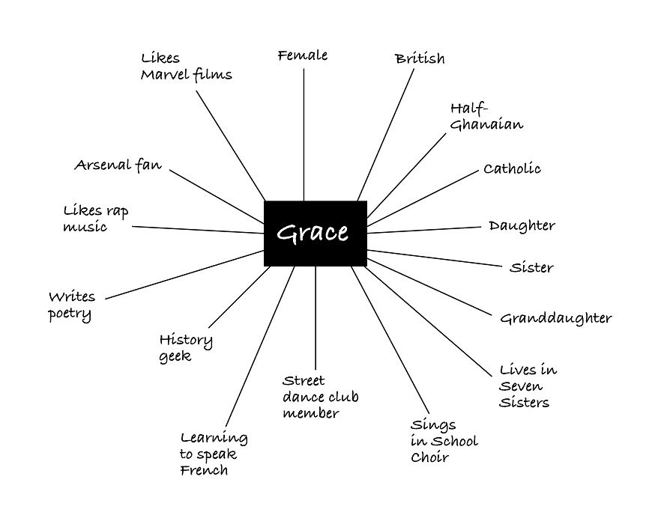
Notes:
Ask students to use the information from their journals to create an identity chart. You might start an identity chart for yourself on the board to help your students understand the format.
Make sure that the students create their identity charts on a new page in their journals because they will be adding to them throughout the lesson and in later lessons.

Slide 7

Others
Others
Others
Others
Others
What words might others use to describe you that you might or might not use to describe yourself?
Notes:
Then have students respond to the prompt in their journals.
After students have written 5–7 ideas, have them return to their identity charts and add this new information.
You can invite them to use a different colour pen for words and phrases that others might use to describe them that they do not consider to be part of their identities. They could also represent this idea by drawing an arrow that points toward the centre, indicating that the idea comes from outside of themselves rather than from within.
Time allowing, see if a few students want to volunteer to share their identity charts with the class.

Slide 8

What parts of your identity do you choose for yourself?
What parts of your identity are determined for you by other people or by society?
Notes:
To debrief the activity, have students think, pair, share their identity charts with a partner.
Let students know that if they don’t feel comfortable showing their charts to their partners or talking about some aspects of their identities, they can talk about some of the things they listed that they feel comfortable sharing.
Invite students to add any new ideas to their charts that arise during their discussions.

Slide 9
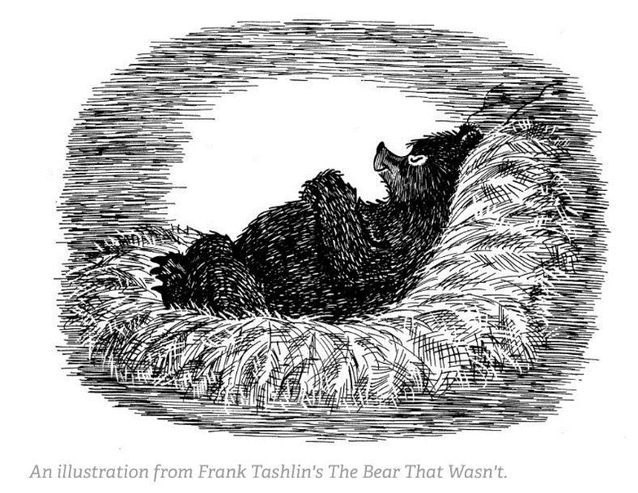
The Bear That Wasn’t
Notes:
Play the video The Bear That Wasn’t (05:32) for your students.
Then pass out copies of the text so that students can refer to them for the discussion of the connection questions at the end of the story.
Alternatively, you might choose a Read Aloud strategy and read The Bear That Wasn’t.

Slide 10
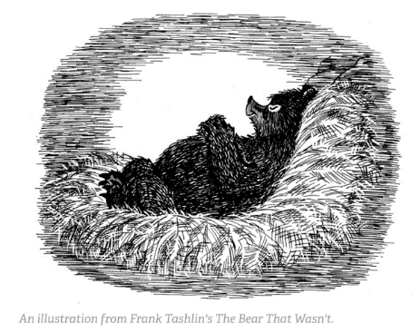
Notes:
Lead a class discussion, analysing the story using the connection questions at the bottom of the reading.
To address the first question, ask students to work with a partner to create an identity chart for the Bear, thinking about which labels represent how he sees himself, and which labels represent how others view him. Give students a few minutes to share their identity charts for the Bear with another pair and encourage them to add words and phrases from others’ charts to their own.

Slide 11

Notes:
Divide the class into small groups so they can discuss the remaining connection questions (listed on the next slide).

Slide 12

Why do you think Frank Tashlin titled this story The Bear That Wasn’t?
Why didn’t the factory officials recognise the Bear for what he was?
Why did it become harder and harder for the Bear to maintain his identity as he moved through the bureaucracy of the factory?
What were the consequences for the Bear of the way others defined his identity?
Whose opinions and beliefs have the greatest effect on how you think about your own identity?
How does our need to be part of a group affect our actions? Why is it so difficult for a person to go against the group?
Bureaucracy – the structure and set of rules that control the activities of people who work for large organisations
Notes:
Project the questions on the board or given them to the students on a printed handout.
If you don’t have time for groups to address all of the questions, you can assign each group one question from the Bear and questions 5-6. It is important that all of the groups have time to talk about questions 5-6 so they can connect the story to their own lives and experiences.

Slide 13

Which parts of your identity do you choose for yourself?
Which parts of your identity are determined for you by other people or by society?
  How does the Bear help you answer these two questions?
  How do your own experiences help you answer these two questions?
Notes:
Close the activity about The Bear that Wasn’t by revisiting this lesson’s guiding questions to explore how the Bear has challenged or confirmed your students’ understanding of the factors that can influence identity.

Slide 14
What parts of your identity do you choose for yourself? What parts of your identity do you feel are determined by others, by society, or by chance?
Whose opinions and beliefs have the greatest effect on how you think about your own identity?
What dilemmas arise when others view you differently than how you view yourself?
What aspects of your identity do you keep private in order to be accepted? What aspects of your identity are you willing to change to fit in?
Notes:
Ask students to reflect on their own identity charts by responding to two or more of the questions in their journals. Let them know that they will not be required to share what they write.
You might ask a few students to volunteer to share from their responses. As students are writing about a personal topic in this reflection, it is important that they not be required to share.

Slide 15





@facinghistory | facinghistory.org

